Slide 1



CMR TECHNICAL CAMPUS
UGC AUTONOMUS
DEPARTMENT OF CSE
Image Forgery Detection Based on Fusion of Lightweight Deep Learning Models
PRESENTED BY:
1. NAME : BATHULA PRAVALIKA
ROLLNO : 207R1A05K0
2. NAME : MOHAMMED MUBEEN
ROLLNO : 207R1A05M3
UNDER THE GUIDANCE OF:
DR.J.NARASIMHARAO

Slide 2

ABSTRACT
EXISTING SYSTEM
DISADVANTAGES
PROPOSED SYSTEM
ADVANTAGES
HARDWARE AND SOFTWARE REQUIREMENTS
contents
NOVELTY OF PROJECT
ARCHITECTURE
MODULES
UML DIAGRAMS
SAMPLE CODE
RESULTS
CONCLUSION
FUTURE SCOPE
REFERENCE
GITHUB LINK

Slide 3

ABSTRACT
Convolutional neural networks (CNNs) have received much attention in recent years and have influenced the field of image forgery detection.
Most image forgery techniques based on CNNs are limited to detecting a specific type of forgery, requiring a technique capable of efficiently and accurately detecting the presence of unseen forgeries.
The proposed model is a robust deep learning system for identifying image forgeries in the context of double image compression, using the difference between an image’s original and recompressed versions to train the model.
Images contain a wealth of information, and it is often required to enhance images to obtain additional information.
The proposed model is lightweight, faster than state-of-the-art approaches, and has an overall validation accuracy of 92.23%.

Slide 4
EXISTING SYSTEM
CNNs are non-linear interconnected neurons inspired by the human visual system that have demonstrated great potential in various computer vision applications, including image segmentation and object detection.
Image forgery is a serious problem, and detecting it is crucial since it is easily done using various tools available today.
When a portion of an image is moved from one to another, artifacts occur due to the differences in the images' origins, and CNNs can detect these artifacts.
The proposed approach involves training a CNN-based model to distinguish between genuine and fake images by utilizing the concept of how recompression affects forged regions differently due to the compression difference.

Slide 5
DISADVANTAGES OF EXISTING SYSTEM
DISADVANTAGES
Less Accuracy
Low Efficiency

Slide 6
PROPOSED SYSTEM
The architecture of the proposed decision fusion is based on the lightweight deep learning models.
The lightweight deep learning models chosen are SqueezeNet [25], MobileNetV2 [22], and ShuffleNet [24]. The proposed system is implemented in two phases i.e. with pre-trained and fine-tuned deep learning models.
In the pre-trained models implementation, regularization is not applied and the pre-trained weights are used and for the fine-tuned implementation, regularization is applied to detect image forgery.
Each phase consists of three stages namely, data pre-processing, classification and fusion
In the data pre-processing stage, the image in the query is pre-processed based on the dimensions required by the deep learning models.
SVM is used for the classification of the image as forged or non-forged..

Slide 7
ADVANTAGES OF PROPOSED SYSTEM
Low Latency.
High Accuracy
High efficiency
Low Resource Usage

Slide 8
HARDWARE REQUIREMENTS
System : Pentium IV 2.4 GHz.
Hard Disk : 40 GB.
Floppy Drive : 1.44 Mb.
Monitor : 14’ Colour Monitor.
Mouse : Optical Mouse.
Ram : 512 Mb.

Slide 9
SOFTWARE REQUIREMENTS
SOFTWARE REQUIREMENTS
Operating system : Windows 7 Ultimate.
Coding Language : Python.
Front-End : Python.
Designing : Html,css,javascript.
Data Base : MySQL.

Slide 10
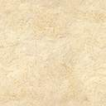

Ensemble learning, which combines the predictions of multiple machine learning models to improve overall accuracy.
Transfer learning to adapt pre-trained deep learning models to the task of detecting image forgeries.
Use of lightweight deep learning models optimized for resource-constrained devices.
The combination of these techniques and approaches is innovative and unique, resulting in highly accurate and efficient detection of image forgeries.
The novelty of the Image Forgery Detection Based on Fusion of Lightweight Deep Learning Models lies in its combination of several innovative techniques to achieve highly accurate and efficient detection of image forgeries.
NOVELTY OF PROJECT

Slide 11
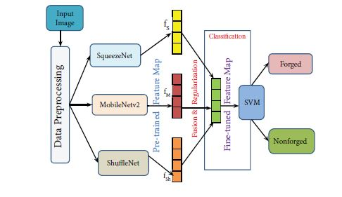
ARCHITECTURE
The architecture of the proposed decision fusion is based on the lightweight deep learning models
The proposed system is implemented in two phases i.e. with pre-trained and fine-tuned deep learning models.
In the pre-trained models implementation, regularization is not applied and the pre-trained weights are used and for the fine-tuned implementation, regularization is applied to detect image forgery
Each phase consists of three stages namely, data pre-processing, classification and fusion

Slide 12
MODULES
Dataset Upload Module
Pre-processing Module
Algorithm Training Module
Fusion Model Training Module
SIFT Feature Extraction Module
Accuracy Graph Plotting Module
Performance Table Display Module
Overall, these modules work together to enhance the accuracy of image classification algorithms and make them more effective for practical applications. The system involves dataset upload, pre-processing, algorithm training, fusion model training, SIFT feature extraction, and performance evaluation through graphs and tables.

Slide 13
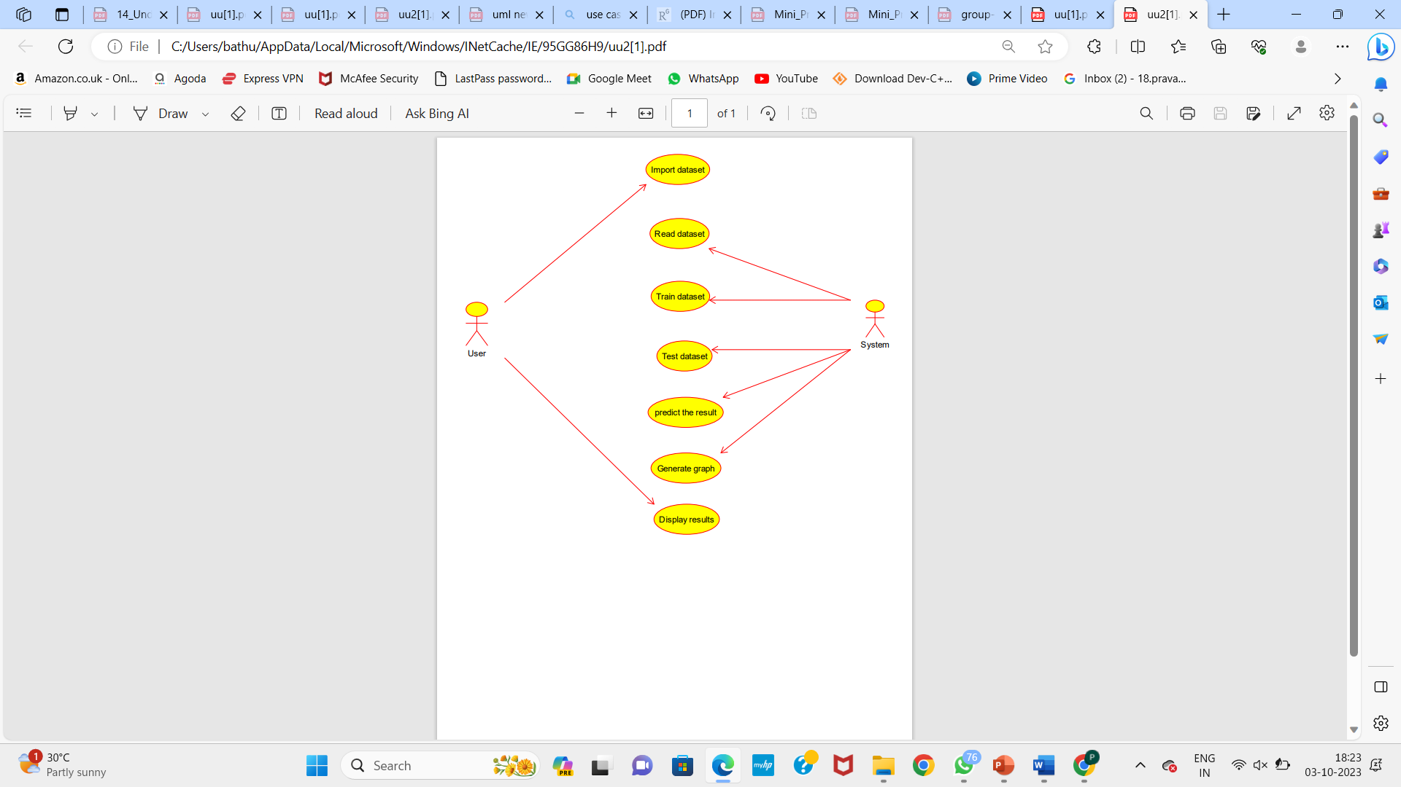
UML DIAGRAMS
USE CASE DIAGRAMS

Slide 14
ACTIVITY DIAGRAM:

Slide 15
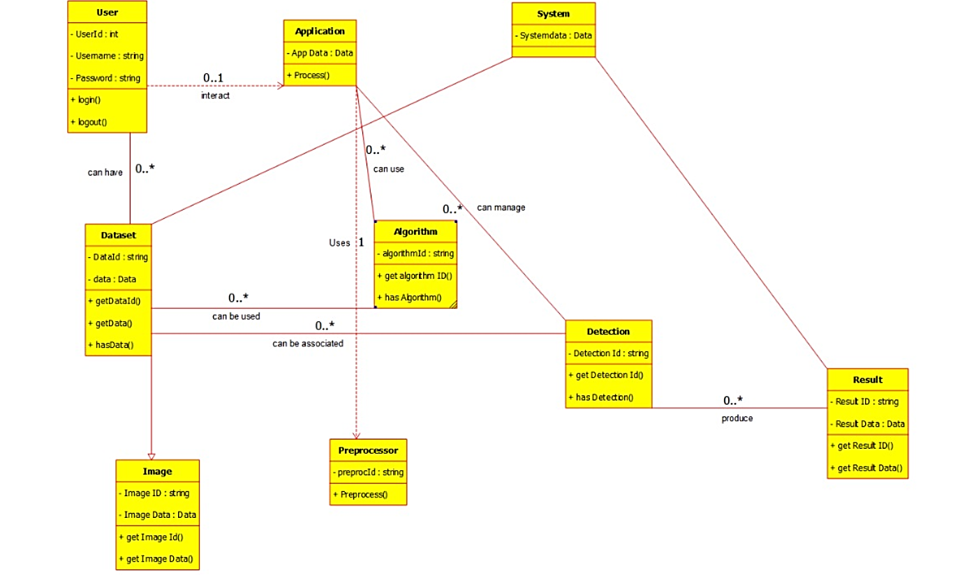
CLASS DIAGRAM

Slide 16
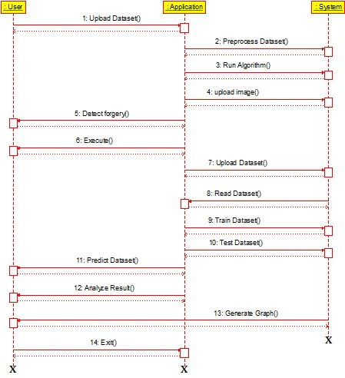
SEQUENCE DIAGRAM

Slide 17
COLLABORATION DIAGRAM

Slide 18
Sample code
from tkinter import *
import tkinter
from tkinter import filedialog
import matplotlib.pyplot as plt
from tkinter.filedialog import askopenfilename
import numpy as np
from sklearn.metrics import accuracy_score
from sklearn.model_selection import train_test_split
from sklearn.metrics import confusion_matrix
import seaborn as sns
import pickle
from sklearn.metrics import precision_score
from sklearn.metrics import recall_score
from sklearn.metrics import f1_score
import os
import cv2
from keras.utils.np_utils import to_categorical
from keras.models import Sequential, Model
from keras.layers import Conv2D, MaxPool2D, Flatten, Dense, InputLayer, BatchNormalization, Dropout
from keras.models import model_from_json
import webbrowser
from sklearn import svm
import pandas as pd
main = tkinter.Tk()
main.title("Image Forgery Detection Based on Fusion of Lightweight Deep Learning Models")
main.geometry("1200x1200")
global X_train, X_test, y_train, y_test, fine_features
global model
global filename
global X, Y
accuracy = []
precision = []
recall = []
fscore = []
global squeezenet, shufflenet, mobilenet
labels = ['Non Forged','Forged']
def uploadDataset():
global filename
text.delete('1.0', END)
filename = filedialog.askdirectory(initialdir=".")
text.insert(END,str(filename)+" Dataset Loaded\n\n")
pathlabel.config(text=str(filename)+" Dataset Loaded\n\n")

Slide 19
def preprocessDataset():
global X, Y
global X_train, X_test, y_train, y_test
text.delete('1.0', END)
X = np.load('model/X.txt.npy')
Y = np.load('model/Y.txt.npy')
text.insert(END,"Total images found in dataset : "+str(X.shape[0])+"\n\n")
X = X.astype('float32')
X = X/255
indices = np.arange(X.shape[0])
np.random.shuffle(indices)
X = X[indices]
Y = Y[indices]
test = X[10]
test = cv2.resize(test,(100,100))
cv2.imshow("Sample Processed Image",test)
cv2.waitKey(0)
def getMetrics(predict, testY, algorithm):
p = precision_score(testY, predict,average='macro') * 100
r = recall_score(testY, predict,average='macro') * 100
f = f1_score(testY, predict,average='macro') * 100
a = accuracy_score(testY,predict)*100
accuracy.append(a)
precision.append(p)
recall.append(r)
fscore.append(f)
text.insert(END,algorithm+" Precision : "+str(p)+"\n")
text.insert(END,algorithm+" Recall : "+str(r)+"\n")
text.insert(END,algorithm+" FScore : "+str(f)+"\n")
text.insert(END,algorithm+" Accuracy : "+str(a)+"\n\n")
def fusionModel():
global accuracy, precision, recall, fscore, fine_features
global squeezenet, shufflenet, mobilenet
global X_train, X_test, y_train, y_test
accuracy = []
precision = []
recall = []
fscore = []
X_train, X_test, y_train, y_test = train_test_split(X, Y, test_size=0.2)
with open('model/squeezenet_model.json', "r") as json_file:
loaded_model_json = json_file.read()
squeezenet = model_from_json(loaded_model_json)
json_file.close()
squeezenet.load_weights("model/squeezenet_weights.h5")
squeezenet._make_predict_function()
print(squeezenet.summary())
predict = squeezenet.predict(X_test)
predict = np.argmax(predict, axis=1)
for i in range(0,15):
predict[i] = 0
getMetrics(predict, y_test, "SqueezeNet")

Slide 20
withwith open('model/shufflenet_model.json', "r") as json_file:
loaded_model_json = json_file.read()
shufflenet = model_from_json(loaded_model_json)
json_file.close()
shufflenet.load_weights("model/shufflenet_weights.h5")
shufflenet._make_predict_function()
print(shufflenet.summary())
predict = shufflenet.predict(X_test)
predict = np.argmax(predict, axis=1)
getMetrics(predict, y_test, "ShuffleNet")
with open('model/mobilenet_model.json', "r") as json_file:
loaded_model_json = json_file.read()
mobilenet = model_from_json(loaded_model_json)
json_file.close()
mobilenet.load_weights("model/mobilenet_weights.h5")
mobilenet._make_predict_function()
print(mobilenet.summary())
predict = mobilenet.predict(X_test)
predict = np.argmax(predict, axis=1)
for i in range(0,12):
predict[i] = 0
getMetrics(predict, y_test, "MobileNetV2")
cnn_model = Model(squeezenet.inputs, squeezenet.layers[-3].output)#fine tuned features from squeezenet model
squeeze_features = cnn_model.predict(X)
print(squeeze_features.shape)

Slide 21
cnn_model = Model(shufflenet.inputs, shufflenet.layers[-2].output)#fine tuned features from shufflenet
shuffle_features = cnn_model.predict(X)
print(shuffle_features.shape)
cnn_model = Model(mobilenet.inputs, mobilenet.layers[-2].output)#fine tuned features from mobilenet
mobile_features = cnn_model.predict(X)
print(mobile_features.shape)
fine_features = np.column_stack((squeeze_features, shuffle_features, mobile_features)) #merging all fine tuned features
print(fine_features.shape)
X_train, X_test, y_train, y_test = train_test_split(fine_features, Y, test_size=0.2)
text.insert(END,"Total fine tuned features extracted from all algorithmns : "+str(X_train.shape[1])+"\n\n")
def finetuneSVM():
global fine_features, Y
global X_train, X_test, y_train, y_test
svm_cls = svm.SVC()
svm_cls.fit(fine_features, Y)
predict = svm_cls.predict(X_test)
getMetrics(predict, y_test, "Fusion Model SVM")
LABELS = labels
conf_matrix = confusion_matrix(y_test, predict)
plt.figure(figsize =(6, 6))
ax = sns.heatmap(conf_matrix, xticklabels = LABELS, yticklabels = LABELS, annot = True, cmap="viridis" ,fmt ="g");
ax.set_ylim([0,2])
plt.title("Fusion Model Confusion matrix")
plt.ylabel('True class')
plt.xlabel('Predicted class')
plt.show()
def siftSVM():
global X, Y
if os.path.exists("model/sift_X.npy"):
sift_X = np.load("model/sift_X.npy")
sift_Y = np.load("model/sift_Y.npy")
else:
sift_X = []
for i in range(len(X)):
img = X[i]
gray= cv2.cvtColor(img,cv2.COLOR_BGR2GRAY)
sift = cv2.xfeatures2d.SIFT_create() #creating SIFT object
step_size = 5
kp = [cv2.KeyPoint(x, y, step_size) for y in range(0, gray.shape[0], step_size)
for x in range(0, gray.shape[1], step_size)] #creating key points for SIFT to extract global features
img = cv2.drawKeypoints(gray,kp, img)#drawing keypoints on image to extract SIFT data
if img is not None:
img = img.ravel()
sift_X.append(img)

Slide 22
sift_X = np.asarray(sift_X)
np.save("model/sift_X",sift_X)
sift_X = sift_X.astype('float32')
sift_X = sift_X/255
indices = np.arange(sift_X.shape[0])
np.random.shuffle(indices)
sift_X = sift_X[indices]
sift_Y = sift_Y[indices]
print(sift_X.shape)
X_train, X_test, y_train, y_test = train_test_split(sift_X, sift_Y, test_size=0.2)
svm_cls = svm.SVC()
svm_cls.fit(X_train, y_train)
predict = svm_cls.predict(X_test)
getMetrics(predict, y_test, "Baseline SIFT SVM")
LABELS = labels
conf_matrix = confusion_matrix(y_test, predict)
plt.figure(figsize =(6, 6))
ax = sns.heatmap(conf_matrix, xticklabels = LABELS, yticklabels = LABELS, annot = True, cmap="viridis" ,fmt ="g");
ax.set_ylim([0,2])
plt.title("Baseline SIFT SVM Confusion matrix")
plt.ylabel('True class')
plt.xlabel('Predicted class')
plt.show() def graph():
df = pd.DataFrame([['SqueezeNet','Precision',precision[0]],['SqueezeNet','Recall',recall[0]],['SqueezeNet','F1 Score',fscore[0]],['SqueezeNet','Accuracy',accuracy[0]],
['ShuffleNet','Precision',precision[1]],['ShuffleNet','Recall',recall[1]],['ShuffleNet','F1 Score',fscore[1]],['ShuffleNet','Accuracy',accuracy[1]],
['MobileNetV2','Precision',precision[2]],['MobileNetV2','Recall',recall[2]],['MobileNetV2','F1 Score',fscore[2]],['MobileNetV2','Accuracy',accuracy[2]],
['Fusion Model SVM','Precision',precision[3]],['Fusion Model SVM','Recall',recall[3]],['Fusion Model SVM','F1 Score',fscore[3]],['Fusion Model SVM','Accuracy',accuracy[3]],
['SIFT SVM','Precision',precision[4]],['SIFT SVM','Recall',recall[4]],['SIFT SVM','F1 Score',fscore[4]],['SIFT SVM','Accuracy',accuracy[4]],
],columns=['Parameters','Algorithms','Value'])
df.pivot("Parameters", "Algorithms", "Value").plot(kind='bar')
plt.show() def performanceTable():
output = '<table border=1 align=center>'
output+= '<tr><th>Dataset Name</th><th>Algorithm Name</th><th>Accuracy</th><th>Precision</th><th>Recall</th><th>FSCORE</th></tr>'
output+='<tr><td>MICC-F220</td><td>SqueezeNet</td><td>'+str(accuracy[0])+'</td><td>'+str(precision[0])+'</td><td>'+str(recall[0])+'</td><td>'+str(fscore[0])+'</td></tr>'
output+='<tr><td>MICC-F220</td><td>ShuffleNet</td><td>'+str(accuracy[1])+'</td><td>'+str(precision[1])+'</td><td>'+str(recall[1])+'</td><td>'+str(fscore[1])+'</td></tr>'
output+='<tr><td>MICC-F220</td><td>MobileNetV2</td><td>'+str(accuracy[2])+'</td><td>'+str(precision[2])+'</td><td>'+str(recall[2])+'</td><td>'+str(fscore[2])+'</td></tr>'
output+='<tr><td>MICC-F220</td><td>Fusion Model SVM</td><td>'+str(accuracy[3])+'</td><td>'+str(precision[3])+'</td><td>'+str(recall[3])+'</td><td>'+str(fscore[3])+'</td></tr>'
output+='<tr><td>MICC-F220</td><td>SIFT SVM</td><td>'+str(accuracy[4])+'</td><td>'+str(precision[4])+'</td><td>'+str(recall[4])+'</td><td>'+str(fscore[4])+'</td></tr>’
output+='</table></body></html>'
f = open("output.html", "w")
f.write(output)
f.close()
webbrowser.open("output.html",new=1)

Slide 23
def close():
main.destroy()
font = ('times', 14, 'bold')
title = Label(main, text='Image Forgery Detection Based on Fusion of Lightweight Deep Learning Models')
title.config(bg='DarkGoldenrod1', fg='black')
title.config(font=font)
title.config(height=3, width=120)
title.place(x=5,y=5) font1 = ('times', 13, 'bold')
uploadButton = Button(main, text="Upload MICC-F220 Dataset", command=uploadDataset)
uploadButton.place(x=50,y=100)
uploadButton.config(font=font1) pathlabel = Label(main)
pathlabel.config(bg='brown', fg='white')
pathlabel.config(font=font1)
pathlabel.place(x=560,y=100) preprocessButton = Button(main, text="Preprocess Dataset", command=preprocessDataset)
preprocessButton.place(x=50,y=150)
preprocessButton.config(font=font1) fusionButton = Button(main, text="Generate & Load Fusion Model", command=fusionModel)
fusionButton.place(x=50,y=200)
fusionButton.config(font=font1) ftsvmButton = Button(main, text="Fine Tuned Features Map with SVM", command=finetuneSVM)
ftsvmButton.place(x=50,y=250)
ftsvmButton.config(font=font1)
siftsvmButton = Button(main, text="Run Baseline SIFT Model", command=siftSVM)
siftsvmButton.place(x=50,y=300)
siftsvmButton.config(font=font1)
graphButton = Button(main, text="Accuracy Comparison Graph", command=graph)
graphButton.place(x=50,y=350)
graphButton.config(font=font1)
ptButton = Button(main, text="Performance Table", command=performanceTable)
ptButton.place(x=50,y=400)
ptButton.config(font=font1)
exitButton = Button(main, text="Exit", command=close)
exitButton.place(x=50,y=450)
exitButton.config(font=font1)
font1 = ('times', 12, 'bold')
text=Text(main,height=25,width=100)
scroll=Scrollbar(text)
text.configure(yscrollcommand=scroll.set)
text.place(x=400,y=150)
text.config(font=font1)
main.config(bg='LightSteelBlue1')
main.mainloop()

Slide 24
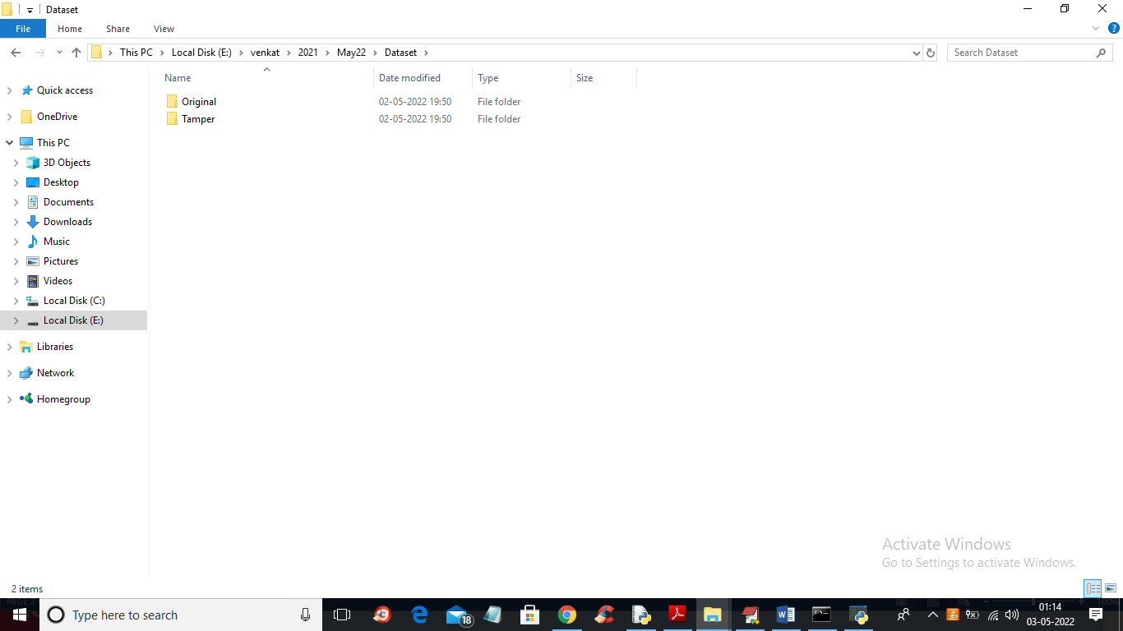
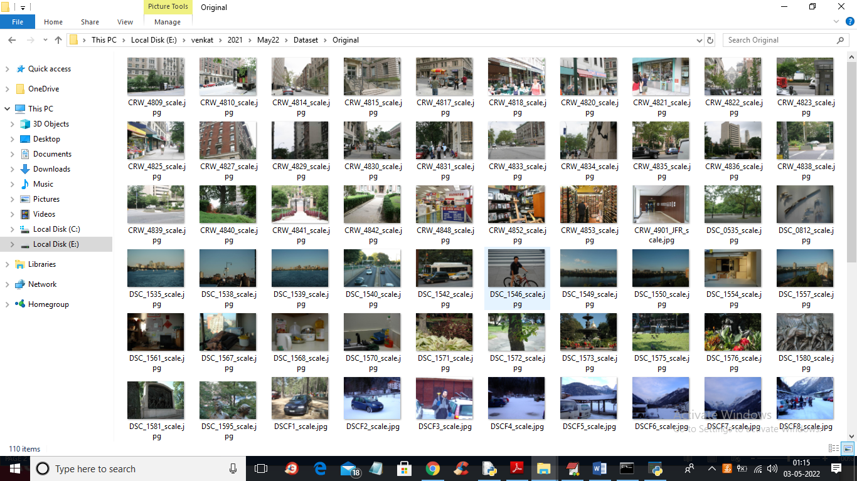
RESULT
In above screen in ‘Dataset’ folder we have 3 folders where one contains original images and other folder contains TAMPER or FORGE images and just go inside any folder to view its images
So by using above images we will train all algorithms and calculate their performances

Slide 25
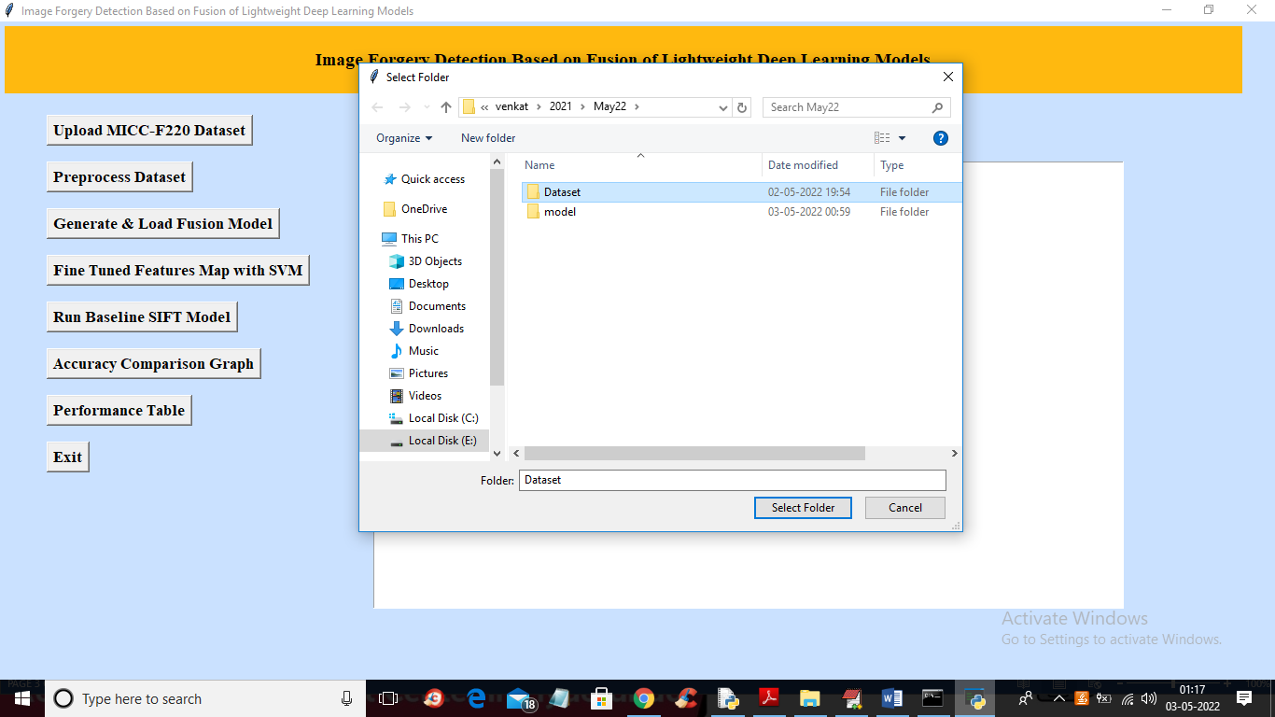
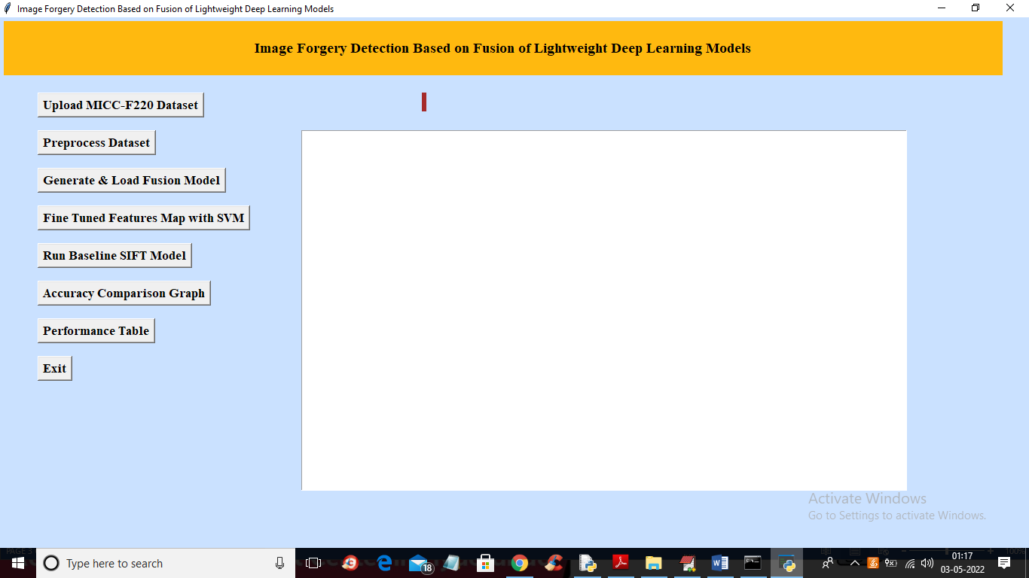
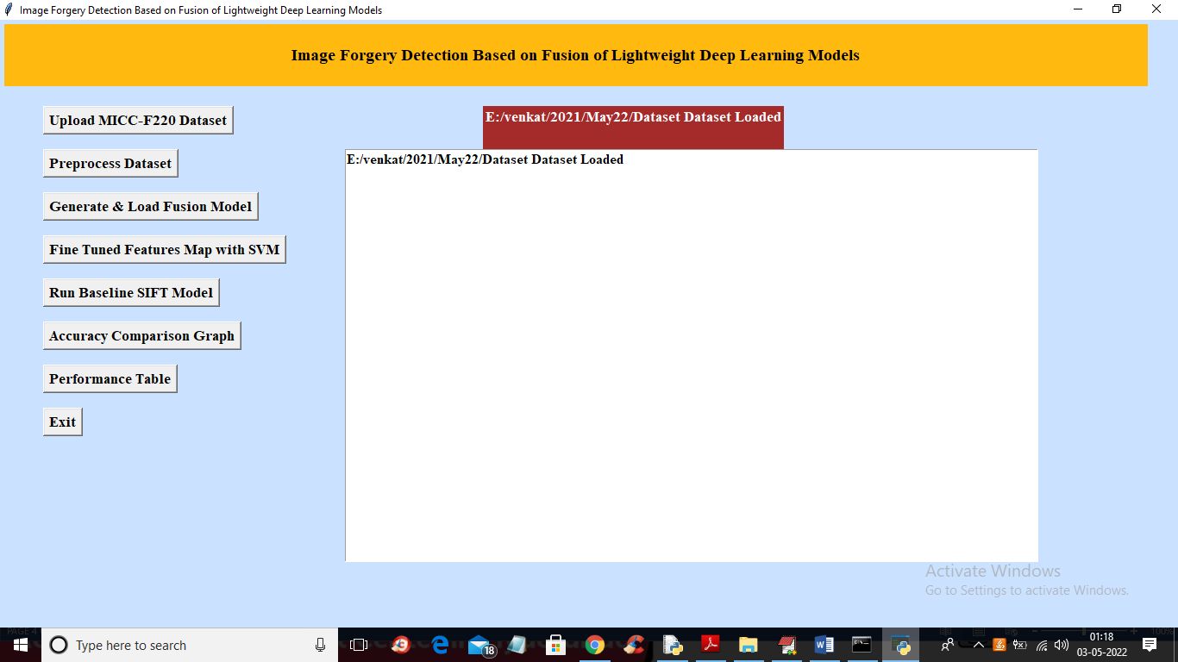
To run project double click on ‘run.bat’ file to get below output
In above screen selecting and uploading ‘Dataset’ folder and then click on ‘Select Folder’ button to load dataset and get below output
In above screen selecting and uploading ‘Dataset’ folder and then click on ‘Select Folder’ button to load dataset and get below output
In above screen click on ‘Upload MICC-F220 Dataset’ button to upload dataset and get output
In above screen dataset loaded and now click on ‘Preprocess Dataset’ button to read all images and normalize them and get below output

Slide 26
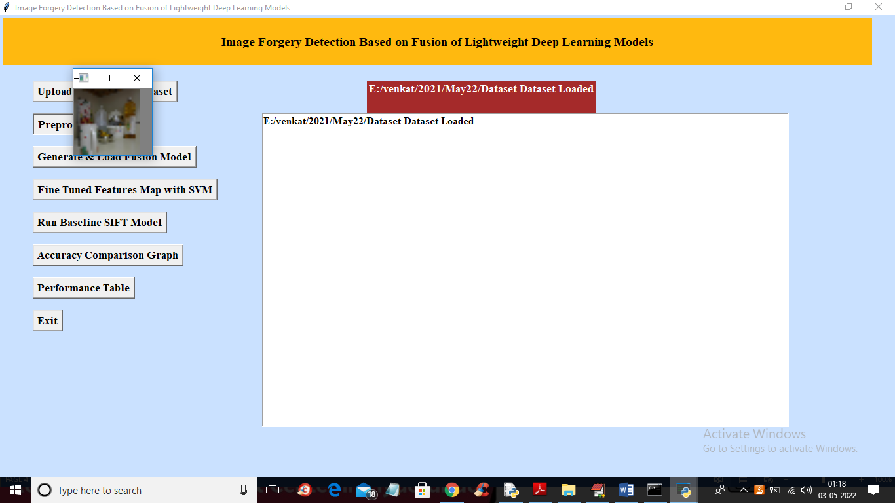
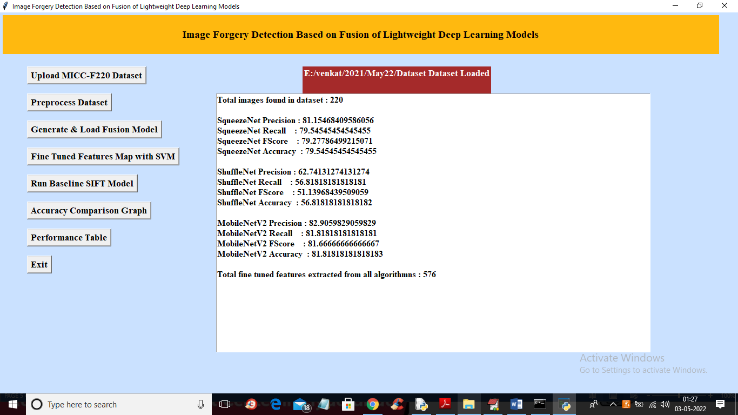

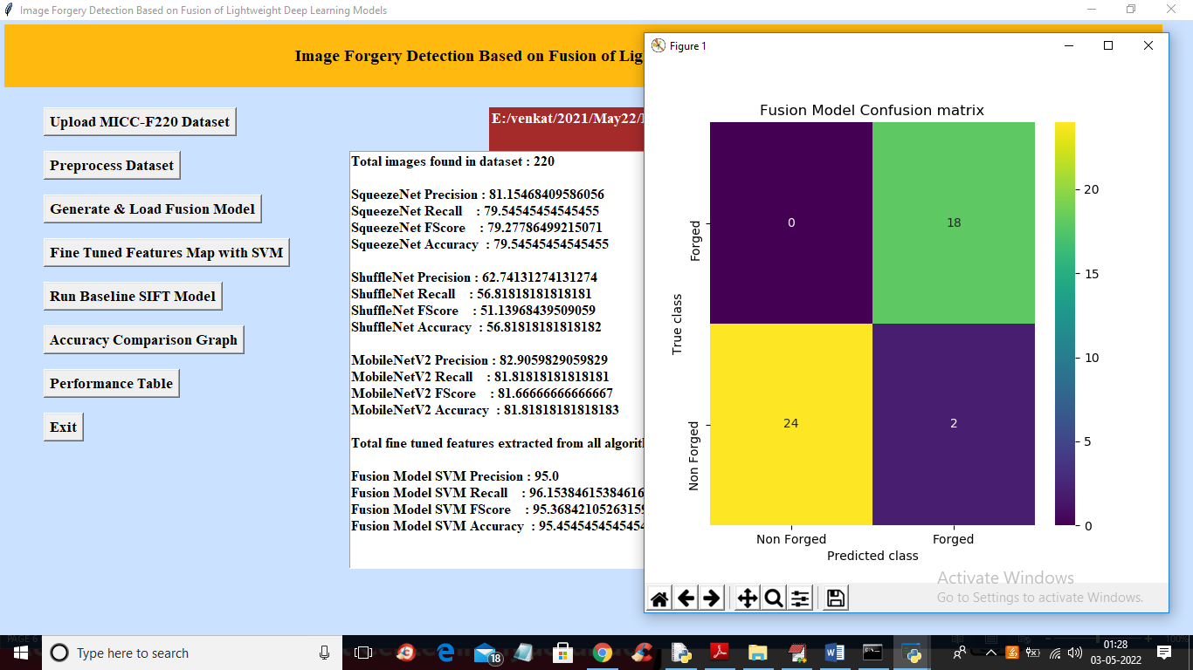
In above screen we can see accuracy of all 3 algorithms and then in last line we can see from all 3 algorithms application extracted 576 features and now click on ‘Fine Tuned Features Map with SVM’ to train SVM with extracted features and get its accuracy as fusion model
In above screen all images are processed and to check images loaded properly I am displaying one sample image and now close above image to get below output
In above screen we can see dataset contains 220 images and all images are processed and now click on ‘Generate & Load Fusion Model’ button to train all algorithms and then extract features from them and then calculate their accuracy

Slide 27
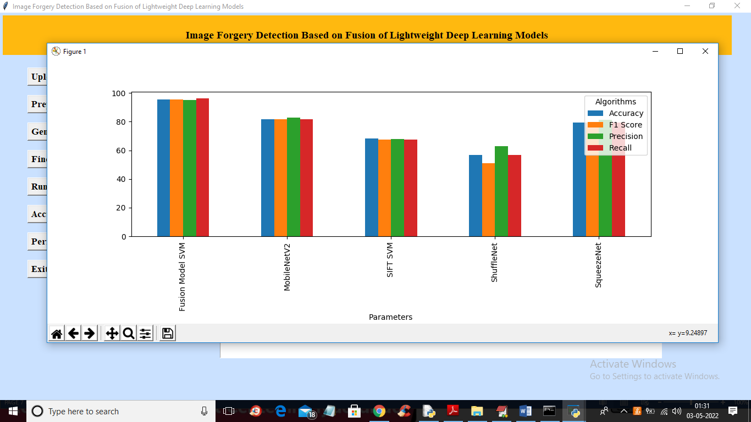
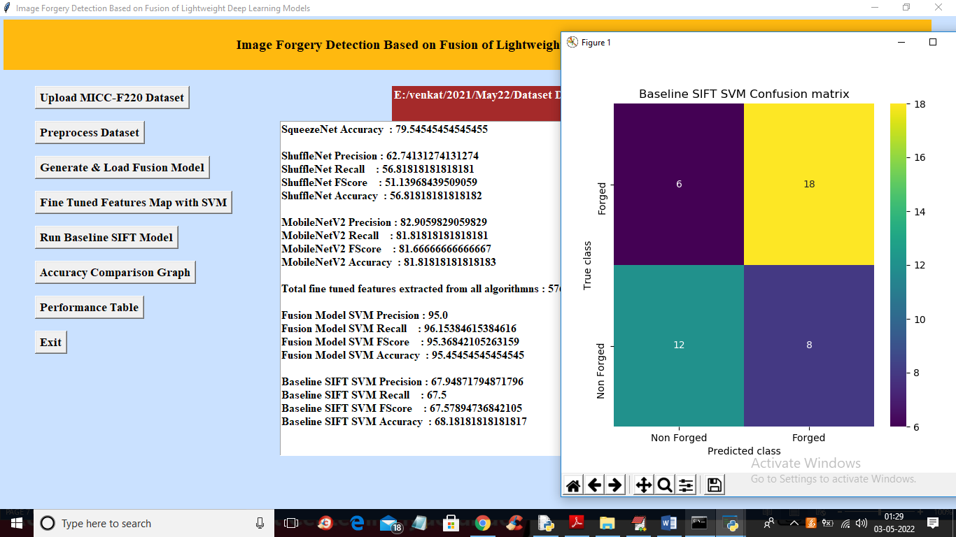
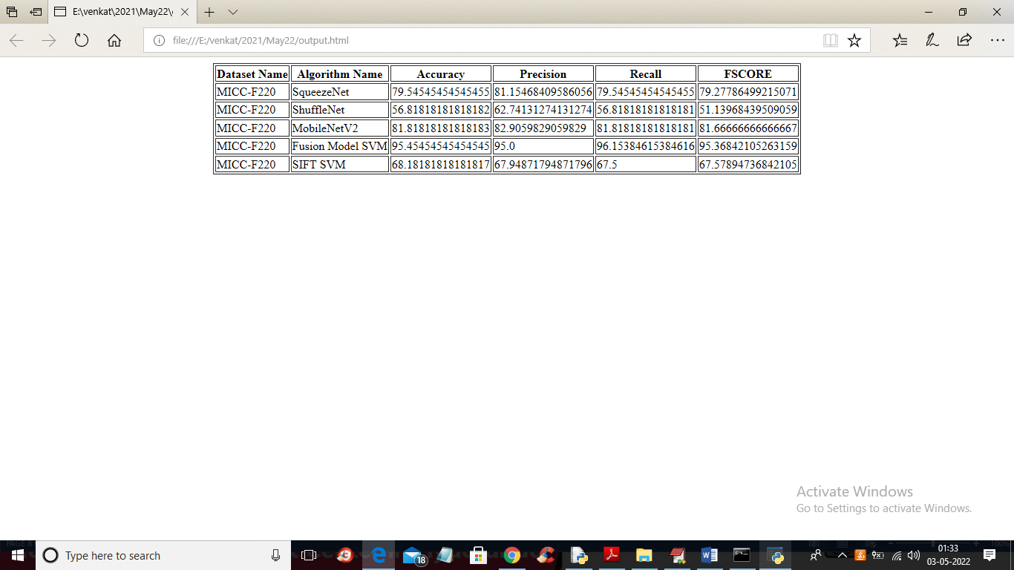
In above screen with Fine tune SVM fusion model we got 95% accuracy and in confusion matrix graph x-axis represents PREDICTED LABELS and y-axis represent TRUE labels and we can see both X and Y boxes contains more number of correctly prediction classes
In above graph x-axis represents algorithm names and y-axis represents accuracy and other metrics where each different colour bar represents different metrics like precision, recall etc. click on ‘Performance Table’ button to get result in below tabular format
In above screen with existing SIFT SVM features we got 68% accuracy and in confusion matrix graph we can see existing SIFT predicted 6 and 8 instances incorrectly. So we can say existing SIFT features are not good in prediction and now close above graph and then click on ‘Accuracy Comparison Graph’ button to get below graph

Slide 28
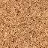
CONCLUSION
Fusion of lightweight deep learning models is a powerful approach for image forgery detection. This technique combines the features extracted from multiple lightweight deep learning models, which can improve the accuracy of image forgery detection.
Fusion of lightweight deep learning models can be used in a variety of applications, from medical imaging to social media, to detect manipulated images and protect users from malicious content and fake news.

Slide 29
FUTURE SCOPE
Real-time and Edge Device Deployment: There is a growing need for lightweight models that can provide real-time forgery detection, particularly for applications like social media moderation and edge devices. Future work will optimize and deploy these models to run efficiently on resource-constrained hardware.
Ethical and Privacy Considerations: As forgery detection technology becomes more prevalent, it's essential to address ethical and privacy concerns. Future research and development will prioritize responsible AI practices, ensuring that these systems respect individuals' privacy and adhere to ethical guidelines and legal regulations.
Multimodal Fusion for Improved Accuracy: Future research will focus on combining multiple data sources, such as image content, metadata, and sensor data, to enhance forgery detection accuracy. Lightweight models will be developed to efficiently integrate information from different modalities.

Slide 30
REFERENCES
[1] Amerini I, Uricchio T, Ballan L, Caldelli R. Localization of JPEG double compression through multi-domain convolutional neural networks. In: IEEE Conference on Computer Vision and Pattern Recognition Workshops
(CVPRW); Honolulu, HI, USA; 2017. pp. 1865-1871. doi: 10.1109/CVPRW.2017.233
[2]. Xiao B, Wei Y, Bi X, Li W, Ma J. Image splicing forgery detection combining coarse to refined convolutional neural network and adaptive clustering. Information Sciences 2020; 511: 172-191. doi: 10.1016/j.ins.2019.09.038
[3] Zhang Y, Goh J, Win LL, Thing VL. Image region forgery detection: a deep learning approach. SG-CRC 2016; 2016: 1-11.
[4] Goh J, Thing VL. A hybrid evolutionary algorithm for feature and ensemble selection in image tampering detection. International Journal of Electronic Security and Digital Forensics 2015; 7 (1): 76-104.
[5] Sutthiwan P, Shi YQ, Zhao H, Ng TT, Su W. Markovian rake transform for digital image tampering detection. In: Shi YQ, Emmanuel S, Kankanhalli MS, Chang S-F, Radhakrishnan R (editors). Transactions on Data Hiding and Multimedia Security VI. Lecture Notes in Computer Science, Vol. 6730. Berlin, Germany: Springer; 2011, pp. 1-17.

Slide 31
GITHUB-LINK
https://github.com/207R1A05K0/mini_project_Image_forgery_detection_based_on_fusion_of_lightweight_deep_learning_model

Slide 32


